Slide 1
FACILITIES LAYOUTS
Facilities layout implies Layout design for equipment, machinery, & furnishings, production, support & personnel areas
A layout is affected by:
centralized or decentralized storage of wip, tooling & fixture
fixed path or variable path handling
unit load size
degree of automation
type & level of inventory & control of materials

Slide 2
CLASSIFICATION OF LAYOUTS
Process Layout
Product Layout
Fixed Position Layout
Hybrid / Cellular / Group Technology Layout
_______________________________________
Process Layout: also named as job shop or functional layout
in this similar equipment & machines are grouped together

Slide 3
CLASSIFICATION OF LAYOUTS (cont..)
Product Layout: It is one in which equipment or work processes are arranged in the sequence in which the product should be made
If the equipment is dedicated to the continual production of narrow product line, this arrangement is usually termed as assembly line

Slide 4
CLASSIFICATION OF LAYOUTS (cont..)
Group Technology/ Cellular Layout:
It brings together dissimilar machines into cells to work on products that have similar design or processing characteristics
A GT Layout is similar to a Process layout, in that cells are designed to perform a specific set of processes, & it is similar to a product layout in that the cells are dedicated to a limited range of products

Slide 5
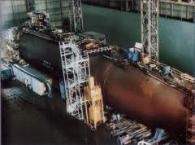
CLASSIFICATION OF LAYOUTS (cont..)
4. Fixed Position Layout:

Slide 6
CLASSIFICATION OF LAYOUTS (cont..)
4. Fixed Position Layout:

Slide 7
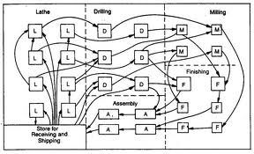
CLASSIFICATION OF LAYOUTS (cont..)
Process Layout:

Slide 8
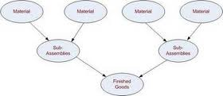
CLASSIFICATION OF LAYOUTS (cont..)
2. Product Layout:

Slide 9
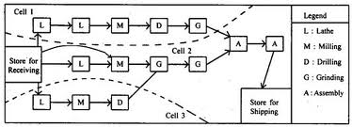
CLASSIFICATION OF LAYOUTS (cont..)
3. Group Technology/Cellular Mfg Layout

Slide 10
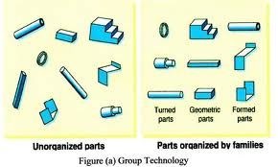
CLASSIFICATION OF LAYOUTS (cont..)
3. Group Technology layout:

Slide 11
LAYOUT DESIGN PROCEDURES
It classified into two class, i.e:
Manual Methods
Computerized Methods
_______________________________________
Manual Methods:
We have techniques like travel chart & Systematic Layout Planning (SLP) under manual layout design.

Slide 12
LAYOUT DESIGN PROCEDURES(Cont..)
MANUAL METHODS:
Systematic Layout Planning (SLP): it has following steps:
Data Collection: This involves the study of product mix, quantity & quality of each product to be produced, routing for each product, support services needed, & schedule.
Flow Analysis: This involves identifying what each department will be, what will be its input & outputs, specification of physical workstations required to do the tasks (in the process plan) etc

Slide 13
LAYOUT DESIGN PROCEDURES(Cont..)
MANUAL METHODS:
Systematic Layout Planning (SLP):
b. at early stages, this involves considerations of quantity of material flow, as well as overall flow lines that will help in process of implementing the tasks in the departments. Examples include: straight line flow, S-shaped flow, U-shaped flow, W-shaped flow,

Slide 14
LAYOUT DESIGN PROCEDURES(Cont..)
MANUAL METHODS:
Systematic Layout Planning (SLP):
c. Quantitative Analysis:
Some factors, such as flow costs, can be quantified
Several others are not so easy to quantify. For example (a) MH receiving & delivery stations to be kept together (b) delicate testing eqpt should be placed from high vibration areas. Such relationship can be drawn on relationship diagram

Slide 15
LAYOUT DESIGN PROCEDURES(Cont..)
MANUAL METHODS:
Systematic Layout Planning (SLP):
4. Relationship diagram: as shown below
Table1
Dept | SR | PC | PS | IC | XT | AT
SR |  | I | I | I | O | A
PC | I |  | X | U | U | E
PS | O | X |  | U | E | E
IC | I | U | U |  | U | E
XT | O | U | E | U |  | I
AT | A | E | E | E | I

Slide 16
LAYOUT DESIGN PROCEDURES(Cont..)
MANUAL METHODS:
Systematic Layout Planning (SLP):
4. Relationship diagram:
Type of Relation | Symbol | V(Relation)
Absolutely Necessary | A | 81
Especially Important | E | 27
Important | I | 9
Ordinary | O | 3
Un important | U | 1
Undesirable | X | 0

Slide 17
LAYOUT DESIGN PROCEDURES(Cont..)
MANUAL METHODS:
Systematic Layout Planning (SLP):
4. Relationship diagram:
Closeness Rating for table1
Department | Total Closeness Rating
SR | 9+3+9+3+81=105
PC | 9+0+1+1+27 = 38
PS | 58
IC | 39
XT | 35
AT | 165

Slide 18
LAYOUT DESIGN PROCEDURES(Cont..)
MANUAL METHODS:
Systematic Layout Planning (SLP):
4. Relationship diagram:
Following the first guess solution (greedy algorithm), initial layout is drawn as:
Fig: Initial layout by SLP
 | SR | XT
PC | AT | PS
 | IC

Slide 19
LAYOUT DESIGN PROCEDURES(Cont..)
MANUAL METHODS:
Systematic Layout Planning (SLP):
5. Space Requirements: These are determined based on industrial standards
6. Space availability: This is determined based on the economic analysis, as well as on other constraints that may arise (especially if the system is to be housed in an existing facility)

Slide 20
LAYOUT DESIGN PROCEDURES(Cont..)
7. Space relationship diagram:
In this part, we substitute the actual area on each department and fit the department into available space
8. Putting in the constraints:
Finally, other existing constraints are employed to cut down the number of feasible solutions, to generate a small set of solutions.

