Slide 1
Material Handling Cost
Main costs involved in designing & operating a material handling system are:
Equipment Cost; this comprises the purchasing of equipment, & auxillary components & installation
Operating Cost; which include maintenance, fuel, & labor cost, consisting of both wages & injury compensation
Unit Purchase Cost; which is associated with purchasing the pallets & containers
Cost due to packaging & damaged material

Slide 2
CONSIDERATIONS IN MATERIAL HANDLING SYSTEM DESIGN
1. Material Characteristics
Category | Measures
Physical state Size Weight Shape Condition Safety risk and risk of damage | Solid, liquid, or gas Volume; length, width, height Weight per piece, weight per unit volume Long and flat, round, square, etc. Hot, cold, wet, etc. Explosive, flammable, toxic; fragile, etc.

Slide 3
CONSIDERATIONS …CONT.
2. Flow rate
Quantity of
material
moved
Conveyors
Conveyors
AGV train
High
Low
Manual handling
Hand trucks
Powered trucks
Unit load AGV
Short
Long
Move Distance

Slide 4
CONSIDERATIONS …CONT.
3. Plant Layout
Layout Type | Characteristics | Typical MH Equipment
Fixed – position Process Product | Large product size, low production rate Variation in product and processing, low and medium production rates Limited product variety, high production rate | Cranes, hoists, industrial trucks Hand trucks, forklift trucks, AGVs Conveyors for product flow, trucks to deliver components to stations.

Slide 5
PRODUCTIVITY RATIOS
Productivity Ratios are used as indicators of the Performance of a system
These ratios are monitored periodically to be sure that their values are within acceptable tolerances
Though some ratios given later, do not specifically address productivity associated with material handling, all the ratios stated here for completeness

Slide 6
PRODUCTIVITY RATIOS (Cont..)
Material-Handling-Labor (MHL) Ratio
= Personnel assigned to Material Handling/
Total Operating Personnel
- The ratio should be less than 1, & a Reasonable value would be less than 0.30 in a plant, while in a warehouse a higher value should be expected

Slide 7
PRODUCTIVITY RATIOS (Cont..)
Handling Equipment Utilization (HEU) Ratio
= items (or load weight) moved per hour/ theoretical capacity
- Ideally, the ratio should be close to 1.0; however, equipment breakdown, poor scheduling, poor housekeeping & building geography can reduce the load movement

Slide 8
PRODUCTIVITY RATIOS (Cont..)
3. Storage Space Utilization (SSU) Ratio
= Storage Space Occupied/
total available storage space
- A value close to 1 indicates assignment of appropriate space for the storage activities

Slide 9
PRODUCTIVITY RATIOS (Cont..)
Aisle Space Percentage (ASP)
= Space occupied by Aisles/
Total Space
ASP should have a value b/w 0.10 & 0.15

Slide 10
PRODUCTIVITY RATIOS (Cont..)
Movement/Operation (MO) Ratio
= number of moves/
number of productive operations
The ratio indicates the amount of material handling performed.
The moves involved may consist of material moved from receiving, from storage to an operation & back to storage, & so on.
A high value indicate room for improvement

Slide 11
PRODUCTIVITY RATIOS (Cont..)
Manufacturing Cycle Efficiency (MCE)
= Time in actual production operations (machine time)/
time in production department
For increasing machine utilization, the delay should be eliminated or at least minimized
The performance index should be observed over a time period for consistency

Slide 12
PRODUCTIVITY RATIOS (Cont..)
Damaged Load (DL) Ratio
= Number of damaged loads /
Total number of Loads
The ratio measures the quality performance of MH Personnel
Damaged to the loads during receiving, in-process movement, & shipping should be minimized

Slide 13
PRODUCTIVITY RATIOS (Cont..)
Energy Ratio
= Total BTU consumption in the warehouse/
Warehouse space
The energy ratio measures the efficiency of heating & cooling operations
Some of the ways in which ratio can be improved are reducing heating & cooling of a portion of the warehouse in which there are no workers, turning lights off when not needed, & using lights on moving vehicles rather than permanent lighting

Slide 14
EQUIPMENT USED FOR MH
Equipment Types:
The equipment can be characterized by the area it is intended to serve:
Between fixed points over a fixed path
Belt conveyor
Roller conveyor
Chute conveyor
Slat conveyor
Screw Conveyor
Chain conveyor
Overhead monorail conveyor
Trolley conveyor
Wheel conveyor
Tow conveyor
Bucket conveyor
Cart-on-track conveyor
Pneumatic tube conveyor

Slide 15
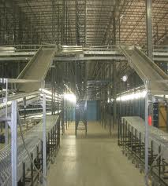
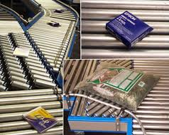
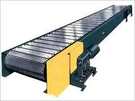
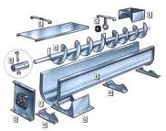
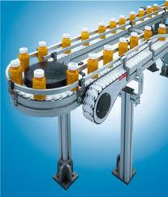
EQUIPMENT USED FOR MH (Cont..)
1. Between Fixed Points & Over fixed path
Belt conveyor
Roller Conveyor
Chute conveyor
Slat Conveyor
Screw Conveyor
Chain conveyor

Slide 16
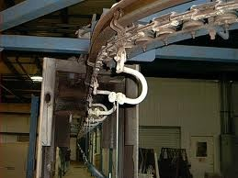
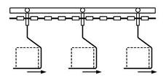
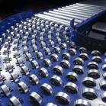
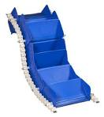
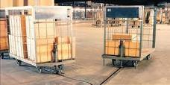
EQUIPMENT USED FOR MH (Cont..)
1. Between Fixed Points & Over fixed path
Overhead monorail conveyor
Trolley Conveyor
Wheel Conveyor
Bucket
conveyor
Tow conveyor

Slide 17
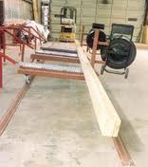
EQUIPMENT USED FOR MH (Cont..)
Between Fixed Points & Over fixed path
Cart-on-Track Conveyor

Slide 18
EQUIPMENT USED FOR MH (Cont..)
Equipment Types:
2. Over Limited Areas
Hoists
Overhead cranes
Hydraulic scissors lift

Slide 19
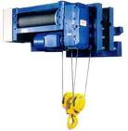
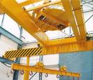
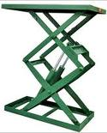
EQUIPMENT USED FOR MH (Cont..)
Equipment Types:
2. Over Limited Areas
Hoist
Overhead crane
Hydraulic scissor lift

Slide 20
EQUIPMENT USED FOR MH (Cont..)
Equipment Types:
3. Over Large Areas
Hand cart/Truck
Tier plate form truck
Hand lift truck/pallet jack
Power driven hand truck
Power driven plat form truck
Fork lift truck
Narrow aisle truck
Tractor-trailer train
Material lift
Drum truck
Drum lifter
Dolley
4. AGVS

Slide 21
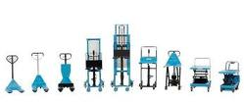
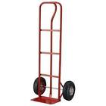
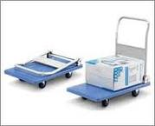
EQUIPMENT USED FOR MH (Cont..)
Equipment Types:
3. Over Large Areas
Hand truck
Tier platform truck
Hand lift truck

Slide 22
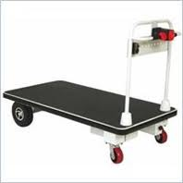
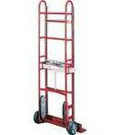
EQUIPMENT USED FOR MH (Cont..)
Equipment Types:
3. Over Large Areas
Power driven hand truck
Power driven platform truck

Slide 23
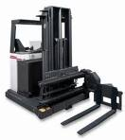
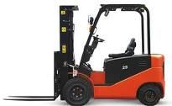
EQUIPMENT USED FOR MH (Cont..)
Equipment Types:
3. Over Large Areas
Fork lift tuck
Narrow aisle truck

Slide 24
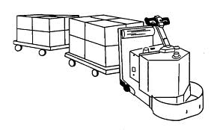
EQUIPMENT USED FOR MH (Cont..)
Equipment Types:
3. Over Large Areas
Tractor Trailer Train
Material lift

Slide 25
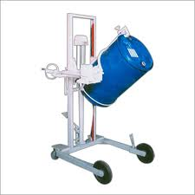
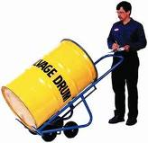
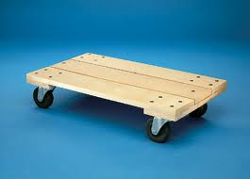
EQUIPMENT USED FOR MH (Cont..)
Equipment Types:
3. Over Large Areas
Drum Truck
Dolly
Drum Lifter

