Slide 1
Industrial Facilities Design
7th Term, Batch:2010

Slide 2
PRODUCTION CHARTS
INTRODUCTION:
Engineers often use charts to represent the process graphically, such an approach increases understanding of the course of action that is needed in manufacturing & help to resolve many problems related to design of the production layout

Slide 3
PRODUCTION CHARTS (cont..)
TYPES:
Assembly charts
Operation/Outline process chart
Flow process chart
Man type flow process chart
Material type flow process chart
Equipment flow process chart
Product analysis flow process chart

Slide 4
PRODUCTION CHARTS (cont..)
TYPES: (cont..)
Other charts
a. Two handled process chart
b. Left hand right hand chart
c. Man machine chart or multiple activity chart
d. Gantt Chart

Slide 5
PRODUCTION CHARTS (cont..)
TYPES: (cont..)
Production diagram
a. Flow diagram
b. String diagram
Other Process Recording Methods
a. Templates
b. Photographs
c. Combined operation chart
d. Material chart
d. SIMO chart
f. Cycle graph
g. Chronocycle graph

Slide 6
PRODUCTION CHARTS (cont..)
SYMBOLS & DESCRIPTIONS
Production charts are drawn by using symbols
standardized by American Society of Mechanical
Engineers (ASME) in 1947.
Sr.# | Symbol | Description
1 | ⃝ | Operation: the item is intentionally changed in one of its characteristics, eg. Filling a bottle with soft drink, bending a metal sheet
2 | → | Transportation: The item is moved from one place to an other (except when the movement occurs as an integral part of an operation or inspection). Eg. Moving an item on conveyer belt b/w operations
3 | □ | Inspection: the unit at an inspection point is compared with the quality standard established for that point

Slide 7
PRODUCTION CHARTS (cont..)
SYMBOLS & DESCRIPTIONS (cont..)
Sr.# | Symbol | Description
4 | D | Delay: the next planned action does not take place. Eg: delay in moving a unit & delay in performance of the next operation
5 | ∆ | Storage: An item is stored in a place such its withdrawal requires authorization

Slide 8
PRODUCTION CHARTS (cont..)
Assembly Chart:
An assembly process chart gives a broad overview of how several parts manufactured separately are to be assembled to make the final product, such as internal combustion engine
It may also show a flow in reverse – how a product that is in unit form is disassembled & distributed in different processes
Important use for an assembly chart is in scheduling production, especially in job shop

Slide 9
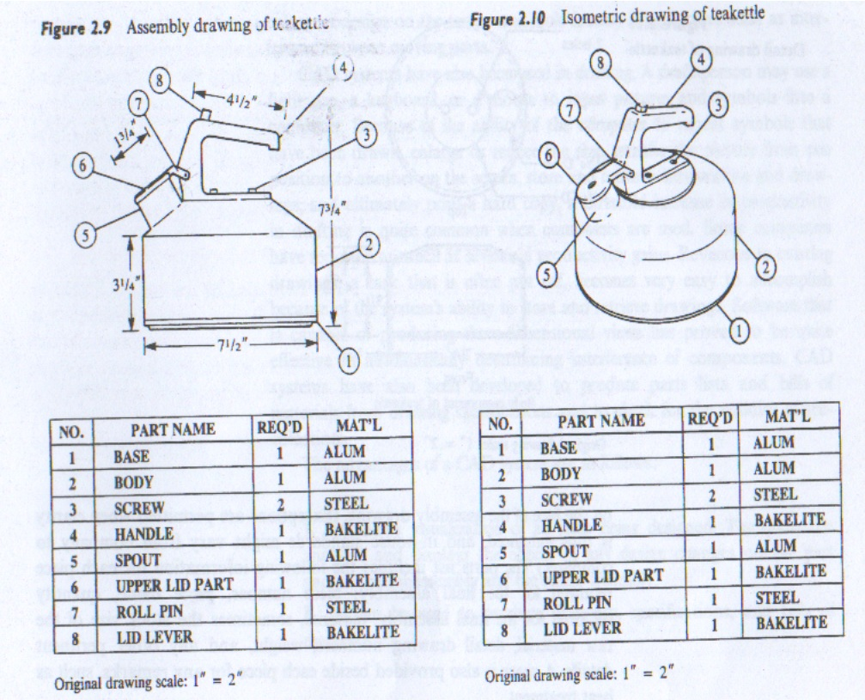
Assembly of Teakettle

Slide 10
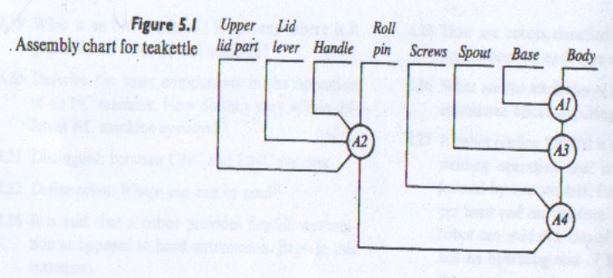
Assembly chart for Teakettle

Slide 11
PRODUCTION CHARTS (cont..)
2. Operation/ Outline Process chart:
It records the main activities of the process through the symbols of operation & inspection only.
This is used to presenting a birds eye view of the entire process
They are used in drawing layout of plant or directing wasteful material or saving in machine tools

Slide 12
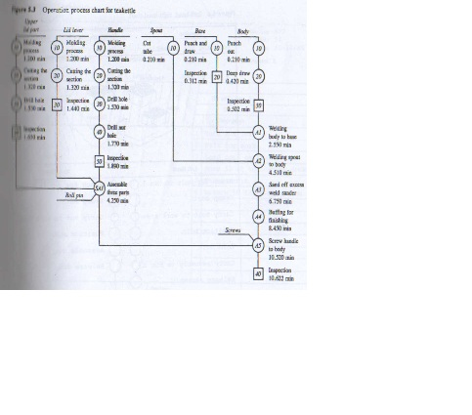
Operation Process chart for Teakettle

Slide 13
PRODUCTION CHARTS (cont..)
3. Flow Process Chart:
This chart uses all 5 activities for method analysis
A single chart only records the activities of only one subject
It is prepared for one component of an assembly at a time
It is used for developing new method
This chart gives information regarding distance moved, & time taken for different elements

Slide 14
PRODUCTION CHARTS (cont..)
3. Flow Process Chart: (cont..)
Flow charts are of 4 types, i.e.
3.1. Man type flow process chart:
- It records what the worker does
3.2. Material type flow process chart:
- It records what happens to material
3.3. Equipment flow process chart:
- It records how the equipment is used
3.4. Product analysis flow process chart:
- It records different steps involved in performing
the work from one stage to another

Slide 15
PRODUCTION CHARTS (cont..)
4. Other Charts
4.1. Two handled process chart:
- It records the activities of two hands but
they are not drawn on time scale 4.2. Left Hand- Right hand chart:
- It record the activities of two hands & they are drawn on time scale

Slide 16
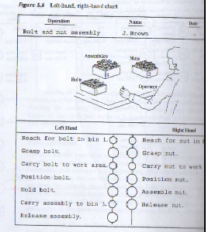
Left-Hand, Right-hand Chart

Slide 17
PRODUCTION CHARTS (cont..)
4. Other Charts (cont..)
4.3. Man machine /Multiple activity / Gang Chart:
- This chart records the activities of man &/or machines on time scale
It depicts the simultaneous activities of all the members in a gang or team or the activities performed by a combination of one or more persons or one or more objects such as people & machines or one person & one machine
The purpose is to visualize all details of work being performed by a team to eliminate or minimize any non productive element for an individual & to obtain a good balance of work among all the team members
4.4. Gantt Chart: do your self

Slide 18
PRODUCTION CHARTS (cont..)
5. Production Diagram
5.1. Flow diagram
It is the plan view of work to a certain scale & a line diagram indicating the path followed by the object under study
It shows the path followed by material, man, equipment

Slide 19
PRODUCTION CHARTS (cont..)
5. Production Diagram (cont..)
5.2. String diagram
This is a scale plan or model on which thread is used to trace & measure the path of workers, material or equipment during specified sequence of events

Slide 20
PRODUCTION CHARTS (cont..)
6. Other Process Recording Methods:
6.1. Models
Proposal for changes in layouts & methods can be visualized by constructing a scale model of the working area
6.2. Templates
A simpler & cheaper representation of layout changes can be made by constructing templates of machines, furniture, & other equipments used
They are drawn to scale as two dimensional outline of the objects & are often made of card board or plastic

Slide 21
PRODUCTION CHARTS (cont..)
6. Other Process Recording Methods: (cont..)
6.3. Photographs
these are used as guide to the actual construction eliminating unnecessary drawing & tracing
6.4. Combined Operation Chart
These are used where both men & material movements are to be recorded together
They are particularly used for investigating paper work routines

Slide 22
PRODUCTION CHARTS (cont..)
6. Other Process Recording Methods: (cont..)
6.5. Material Chart
This is used to record the relationship of the different parts or components of a product & their sequence of assembly
6.6. SIMO Chart
i.e Simultaneous Motion Chart
This is similar to two hand charts with the difference that the time required for each motion is drawn to scale with vertical axis & some time colored to represent the particular motion

Slide 23
PRODUCTION CHARTS (cont..)
6. Other Process Recording Methods: (cont..)
6.7. Cycle graph
A small electric bulb is attached to the finger, hand or the other part of the body of the operator & it is photographed to record the path of the motion.
The path of light so photographed is called cycle graph

Slide 24
PRODUCTION CHARTS (cont..)
6. Other Process Recording Methods: (cont..)
6.8. Chronocycle graph
If an interrupter is placed in the electric circuit with the bulb & the light is flashed quickly & off slowly then the path of bulb in the photograph will appear as a dotted line with pear shaped dots indicating the direction of motions
the space b/w the dots will be according the speed of hand of finger of the body
The size & shape of the peered shaped dot will show whether the body part is in acceleration or in retardation
The number of dots will give the time taken by that part such a record is called Chronocycle graph

