Slide 1
MATERIAL HANDLING: PRINCIPLES & EQUIPMENT DESCRIPTION
Definition of Material Handling:
“ Material Handling embraces all of the basic operations involve in movement of bulk, packaged, & individual products in semisolid or solid state by means of machinery, & within the limits of place of business”
By: MHI (Material Handling Institute)

Slide 2
OBJECTIVE OF MH
To increase efficiency of material flow by ensuring availability of materials when & where they needed
To reduce MH cost
To improve facilities utilization
To improve safety & working conditions
To facilitate mfg processes
To increase productivity

Slide 3
MH EQUIPMENT TYPES
All Equipments in MH are classified in three main types, i.e
Conveyors:
Conveyors are used for moving materials continuously over a fixed path. Examples of different conveyors are; roller, belt, & chute conveyors

Slide 4
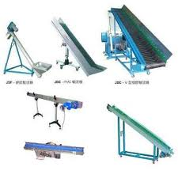
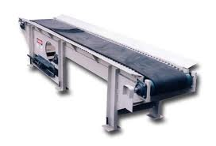
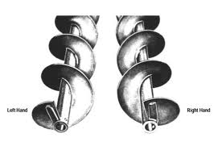
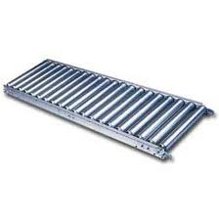
MH EQUIPMENT TYPES (Cont..)
Belt conveyor Conveyor m/cs
Handconveyor Roller Conveyor
Hand Conveyor Roller Conveyor

Slide 5
MH EQUIPMENT TYPES (Cont..)
1. Conveyors:
Advantage
Permits high capacity for moving large number of items
Their speed is adjustable
Handling combined with other activities such as processing & inspection is possible
They are versatile & can be on floor or overhead
Temporary storage of loads b/w work station is possible (particularly overhead conveyors)
Load transfer is automatic & does not require the assistance of many operators
Straight line paths or aisles are not required
Utilization of the cube is feasible through the use of overhead conveyors

Slide 6
MH EQUIPMENT TYPES (Cont..)
1. Conveyors:
Disadvantages:
They allow a fixed path, serving only limited areas
Bottlenecks can develop in the system
A breakdown in any part of the conveyor stops the entire line
Since conveyors are fixed in position, they hinder the movement of mobile equipment on the floor

Slide 7
MH EQUIPMENT TYPES (Cont..)
Cranes & Hoists
Cranes & Hoists are items of overhead equipment for moving loads intermittently within a limited area. Bridge cranes, monorail cranes, & hoists are examples of this basic equipment type

Slide 8
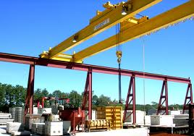
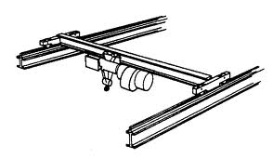
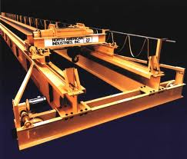
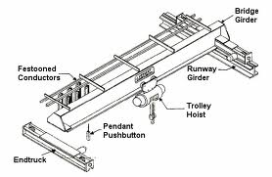
MH EQUIPMENT TYPES (Cont..)
Cranes & Hoists:
Bridge Crane

Slide 9
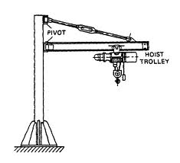
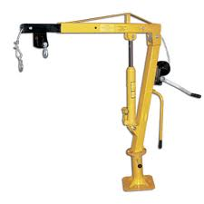
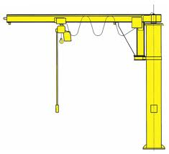
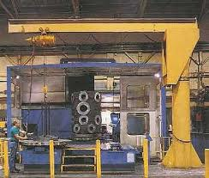
MH EQUIPMENT TYPES (Cont..)
Cranes & Hoists:
Jib Cranes

Slide 10
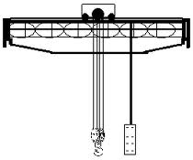
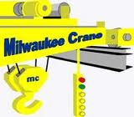
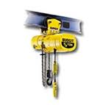
MH EQUIPMENT TYPES (Cont..)
Cranes & Hoists:
Monorail Cranes & Hoists

Slide 11
MH EQUIPMENT TYPES (Cont..)
2. Cranes & Hoists
Advantages:
Lifting as well as transferring of material is possible
Interference with the work on the floor is minimized
Valuable floor space is saved for truck rather than being utilized for installation of handling equipment
Such equipment is capable of handling heavy loads
Such equipment can be used for loading & unloading of materials

Slide 12
MH EQUIPMENT TYPES (Cont..)
2. Cranes & Hoists
Disadvantages:
They require heavy investment (especially bridge cranes)
They serve a limited area
Some cranes move only in straight line & thus can not make turns
Utilization may not be as high as desirable since cranes are used only for a short time during daily work
An operator has to be available for operating some types, such as bridge cranes
Applications:
Shipyards & heavy equipment production facilities

Slide 13
MH EQUIPMENT TYPES (Cont..)
Trucks
Hand or Powered Trucks move loads over varying paths Examples of such Trucks include Lift Trucks, Fork Trucks, Trailer Trains, & Automated Guided Vehicles

Slide 14
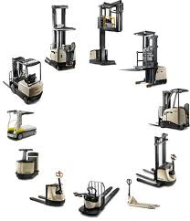
MH EQUIPMENT TYPES (Cont..)
Trucks
Lift Trucks:

Slide 15
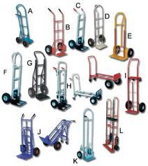
MH EQUIPMENT TYPES (Cont..)
Trucks
Hand Trucks:

Slide 16
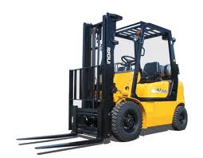
MH EQUIPMENT TYPES (Cont..)
Trucks
Fork Trucks:

Slide 17
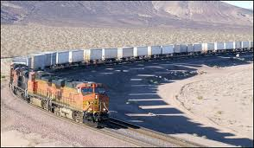
MH EQUIPMENT TYPES (Cont..)
Trucks
Trailer Trains:

Slide 18
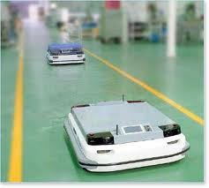
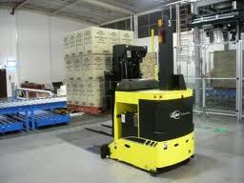
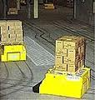
MH EQUIPMENT TYPES (Cont..)
3. Trucks
AGVs:

Slide 19
MH EQUIPMENT TYPES (Cont..)
3. Trucks
Advantages:
They are not require to follow a fixed path of movement & therefore can be used any where on the floor where space permits
They are capable of loading, unloading, & lifting, in addition to transferring material
Because of their unrestricted mobility, which allows them to serve different areas, trucks can achieve high utilization

Slide 20
MH EQUIPMENT TYPES (Cont..)
3. Trucks
Disadvantages:
They cannot handle heavy loads
They limited capacity per trip
Aisles are require; other wise the trucks will interfere with the work on the floor
Most trucks have to be driven by an operator
Trucks do not allow handling to be combined with processing & inspection, as other type of eqpt do

Slide 21
DEGREE OF MACHANIZATION IN MH
A MH System can be completely manual or fully automated;
Different degrees of mechanization also exist between these two extrems
Level of Mechanization in MH System is classified with respect of Source of power for handling, degree of human involvement & computers in operating the eqpt

Slide 22
DEGREE OF MACHANIZATION IN MH (Cont..)
Level of Mechanization can be classified as:
Manual & Dependent on Physical Effort:
This level also includes manually driven equipment such as hand truck
Mechanized:
Power instead of physical effort is used for driving the eqpt. Some trucks, conveyors, & cranes fall into this level. Here operators are needed for operating the eqpt as opposed providing the power
3. Mechanized Complemented with Computers:
It is an extension of 2nd level
The function of the computers is to generate documents specifying the Moves & Operations

Slide 23
DEGREE OF MACHANIZATION IN MH (Cont..)
Level of Mechanization can be classified as:
4. Automated:
Minimum human intervention is used for driving & operating the eqpt, & most of these functions are performed by computers.
Examples includes Conveyors, AGVs, & AS/RS
The equipment usually receives instructions form key boards, pushbuttons, & tape or card readers

Slide 24
DEGREE OF MACHANIZATION IN MH (Cont..)
Level of Mechanization can be classified as:
Fully Automated:
This level is similar to the 4th level, but computers perform the additional task of on-line control, thus eliminating the need for human intervention
The cost & complexity of designing the system
increases as the degree of mechanization
increases. However, efficiency of operations &
labor savings can result

Slide 25
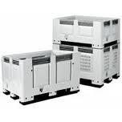
UNIT LOAD CONCEPT
Unit Load:
“ It is defined as number of items arranged such that they can be handled as a single object”
Unit load can be accomplished by:
Palletization: It is assembling & Securing of individual items on a platform that can be moved by a truck or a crane
Palllet

Slide 26
UNIT LOAD CONCEPT (Cont..)
Unit load can be accomplished by:
2. Unitization: It is also the assembling of goods, but as one compact load. Unlike Palletization additional materials are used for packaging & wrapping the items as a complete unit

Slide 27
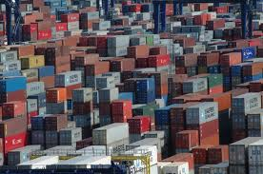
UNIT LOAD CONCEPT (Cont..)
Unit load can be accomplished by:
3. Containerization: It is assembling of items in a box or a bin. It is most suitable for use with conveyors, especially for small items

Slide 28
UNIT LOAD CONCEPT (Cont..)
In general, the factors that influence the solution of the unit load type are the weight, size, & shape of the material; compatibility with the material handling equipment; cost of the unit load; & the additional functions provided by the unit load stacking & protection of material

Slide 29
PRINCIPLES OF MH
There are no definite rules that can be followed for achieving a successful material –handling system.
There are, however, several guidelines that can result in reducing the system cost & in enhancing efficiency
These guidelines are known as Principles of Material Handling
There are 20 Principle of Material Handling

Slide 30
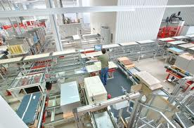
PRINCIPLES OF MH (Cont..)
Planning: Plan all MH & Storage activities to obtain maximum overall operating efficiency
System Flow: Integrate as many handling activities as is practical into a coordinated system of operations covering vendor, receiving, storage, production, inspection, packaging, warehousing, shipping, transportation, & customer

Slide 31
PRINCIPLES OF MH (Cont..)
Material Flow: Provide an operation sequence & equipment layout optimizing material flow
Simplification: Simplify handling by reducing, eliminating, or combining unnecessary movements &/or equipment
Gravity: Use gravity to material handling whenever practical
Space Utilization: Make optimum utilization of the building cube
Unit Size: Increase the quantity, size or weight of unit loads or flow rate
Mechanization: Mechanize handling operations
Automation: Provide automation to include production, handling & storage functions

Slide 32
PRINCIPLES OF MH (Cont..)
10. Equipment Selection: In selecting handling equipment, consider all aspects of the material handled, the movement, & the method to be used
Standardization: Standardize handling methods as well as type & sizes of handling equipment
Adaptability: Use methods & equipment that can best perform a variety of tasks & applications when special-purpose equipment is not justified
Dead Weight: Reduce the ratio of dead weight of mobile handling equipment to load carried
Utilization: Plan for optimum utilization of handling equipment & manpower

Slide 33
PRINCIPLES OF MH (Cont..)
15. Maintenance: Plan for preventive maintenance & schedule repairs of all handling equipments
16. Obsolescence: Replace obsolete handling methods & equipment when more efficient methods of equipment will improve operations
17. Control: Use material Handling activities to improve control of production, inventory & order handling
18. Capacity: Use handling equipment to help achieve the desired production capacity
19. Performance: Determine the effectiveness of handling performance in terms of expense per unit handled
20. Safety: Provide suitable methods & equipment for safe handling

